Slide 1
Print Stream – Estimating Lunch & Learn
Date Here
Notes:
@ 1 minutes intro – Goal of session
You have:
Good afternoon, And Welcome to Estimating Lunch and Learn,
I am Brian Norman, and this is Elsa Keil as part of the Estimating Team from ENPOINTE,
We would like to Start by Showing you how and why the reasoning we use when creating suggested sell pricing for the Sale Department for our Clients.
Suggest: General Greeting
– Today I will be walking you through the basics of estimating. Elsa Keil will be helping me show you the “Why & How” of creating the suggested sell prices for sales using the Print Stream system.

Slide 2
What Equipment is chosen for estimates and why? – Overview of Process
Estimating Team represents over 100 years in print industry
Specification Sheets -- Gives parameters on production equipment. Includes size minimums/maximums, grain directions if needed, equipment capabilities (i.e. pockets on equipment) and detailed information on what is included on that equipment (helpers, etc.).
With the above as given – estimators review information and assess what production method best suits the project.
Notes:
@ 3 minutes
Overview of what estimating process entails
You have: How do we derive how and where to produce a product for our clients, This Starts from the Specification Sheets provided tom Estimating by Operations. These are tools for estimating which are used to create best case scenarios based on specification for each piece of equipment based on processes need to complete the project.
Suggest:
The most efficient and price effective selling price is provided to sales based on the estimator’s knowledge of our production equipment (based on Specification Sheets which are provided to Estimating by Production). These sheets are used as tools by estimating to select the more efficient way to estimate/produce a project.

Slide 3
How do we know Spec Sheets are accurate.
Original specification sheets were based on original equipment specifications and historical data from production.
Any changes to equipment capabilities (i.e. number of pockets, size minimum/maximum) must be updated on the Spec Sheet by the “Owner” of the sheet then reviewed and approved.
Note: These are internally controlled forms and proper SOP must be followed.
Notes:
@ 1 minutes
You have:
Show 2nd Slide How we know Specification sheets are accurate, along with why these are an internal controlled document.
Show Fuego Plow Fold and Explain how this is estimated and the purpose behind it,
Show Stitcher and explain how helpers are incorporated per pockets used etc.
Suggest:
To give you an idea of the type of information contained withing the Specification Sheets, here are two example. Note that these spec sheets were based on
equipment specifications as well as historical data for our actual production capabilities
Sheets are updated by Production/Operations to reflect any changes

Slide 4
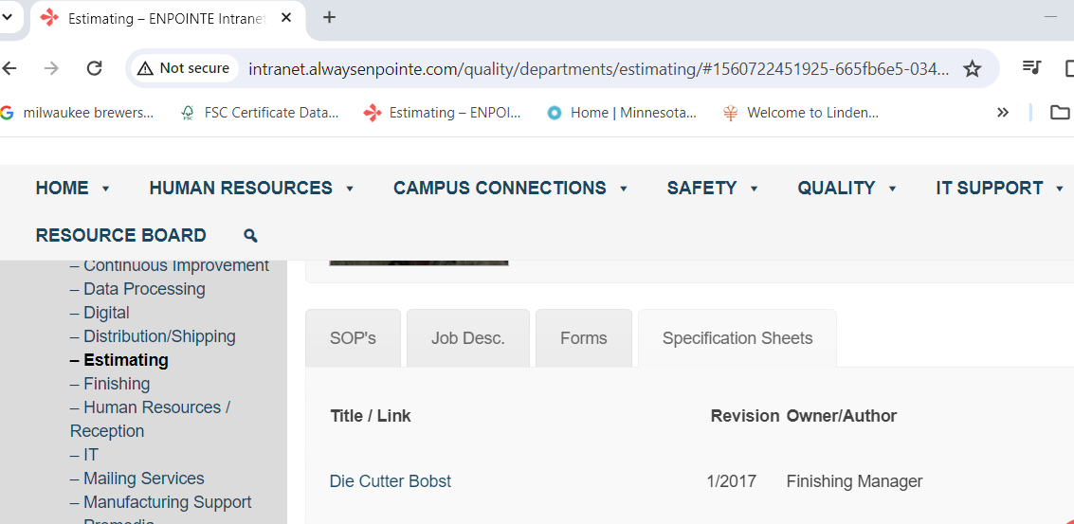
Specification Sheet:
Found on Intranet: Quality – Departments – Estimating
Then Specification Sheets Tab
Notes:
@ 1min
Specification Sheets can be found on the Intranet……

Slide 5
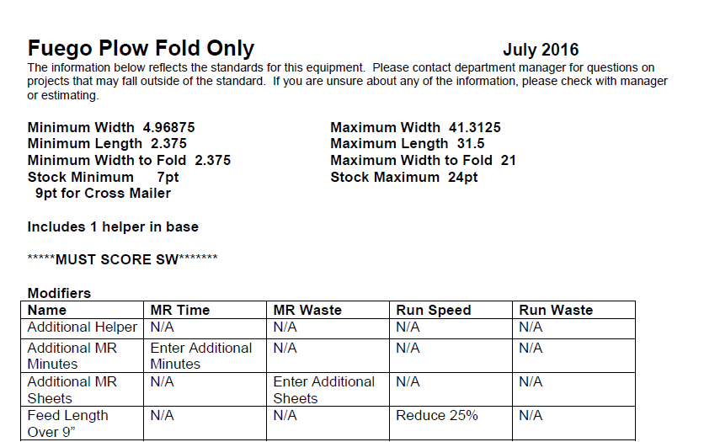
Fuego Example Sheet
Fuego-Plow-Fold-Only Example Spec Sheet.pdf
Notes:
@ 2 minutes
Here is an example of the Fuego Plow Fold only Specification sheet.
Note on this sheets you see what the minimum/maximum sizes are as well as stock requirements
Modifiers are used by estimators to make modifications on run speed, etc. directly in the equipment entry in Print Stream

Slide 6
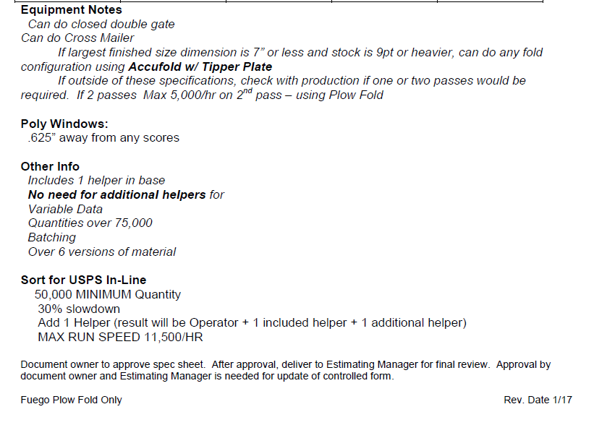
Fuego Spec Sheet - Continued
Notes:
@ 1 minute
Here is further detailed information regarding what we can/cannot do on the piece of equipment.
Discuss extra information included on sheet

Slide 7
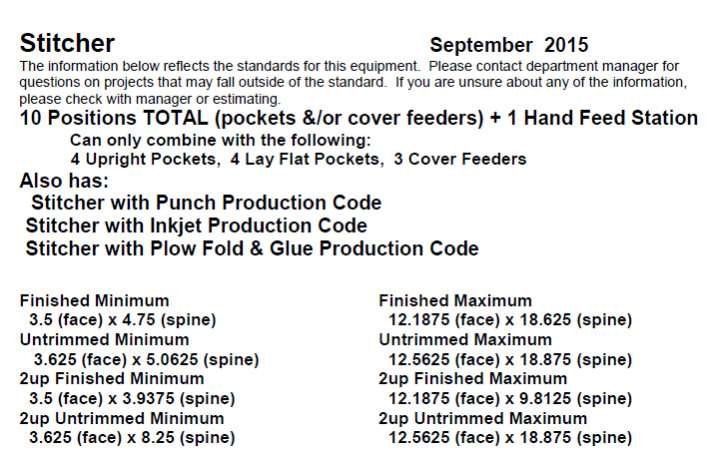
Stitcher Example Sheet
Stitcher Example Spec Sheet.pdf
Notes:
@ 2 minutes
Here is an example of the Stitcher Specification sheet.
Note on this sheets you see what the minimum/maximum sizes are as well as stock requirements

Slide 8
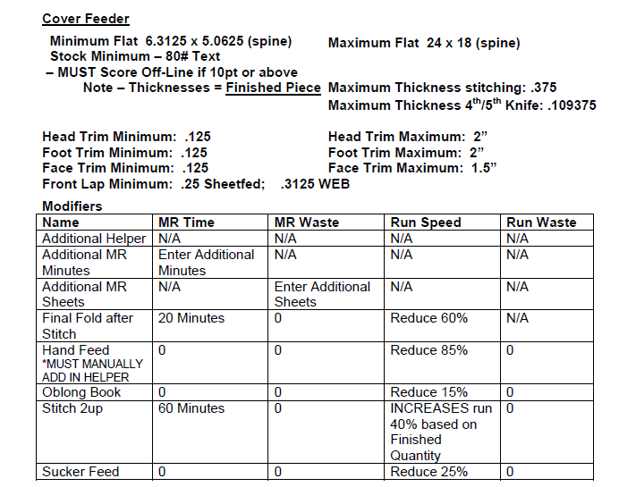
Stitcher Spec Sheet - Continued
Notes:
2 Minute
Again, additional size/stock requirements are listed for the equipment as well as modifiers

Slide 9
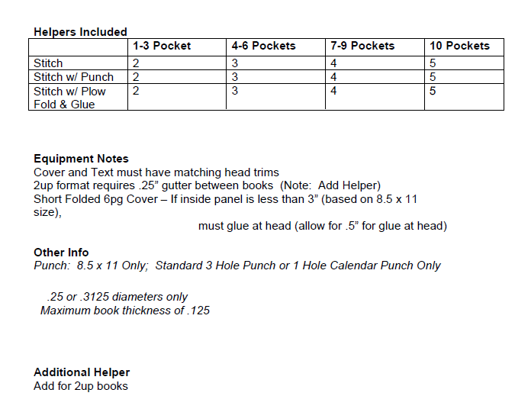
Stitcher Spec Sheet - Continued
Notes:
@ 2 minutes
NOTE THE HELPERS INCLUDED – Explain how these helpers are incorporated into the actual equipment hourly rate on estimate

Slide 10
How equipment information is entered into Print Stream
Master Files Print in Print Stream holds all information for production equipment needed to create an estimated sell price for our clients.
Run Speeds, make-ready times are entered in Master Files Print which is then automatically brought into the Estimate. Note that run speeds are often quantity driven so higher quantities would run faster than lower quantities
Hourly equipment rates are entered in this area.
Automatic number of helpers are entered in Master Files Print based on equipment standards.
Certain “Modifiers” can be attached to the production function in the Estimate that will affect run speed, helpers, etc.
Notes:
@ 5 minutes
You Have: How is and why equipment is built in Master Files Print to create a suggested sell price for our clients?
Show example of the 6/40 Press and Show how Quantity’s effect run Speeds.
(Expound on the fact that these are yield speeds Not actual Press running Speeds)
Show modifiers to demonstrate what they do and how they are used in creating a suggested sell price.
Suggest – run through bullet points above
Subsequent slides show examples of 6/40

Slide 11
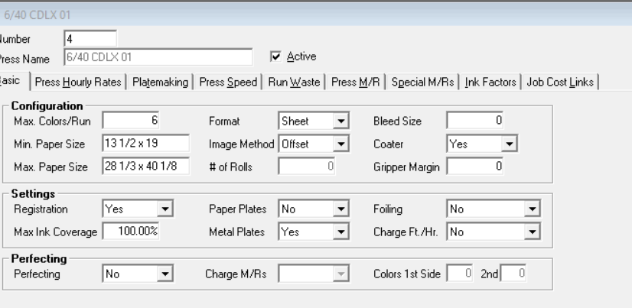
Master File Print Example – 6/40
Basic Information contains min/max sheet sizes type of press etc.
Notes:
1 min

Slide 12
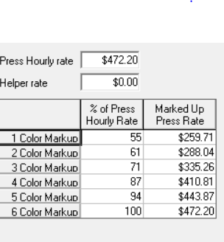

Press Rates and Platemaking Rates are determined by Accounting – Not Estimating
Notes:
1 min

Slide 13
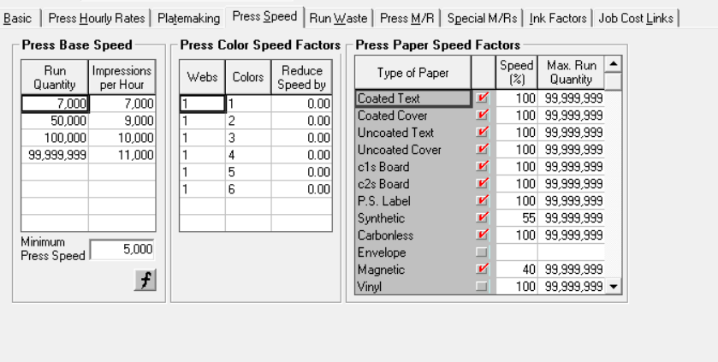
Press Run Speeds
Notes:
1 min
Note that impressions per hour are based on quantities
Automatic slow-downs for special stocks (i.e. synthetic, magnetic)

Slide 14
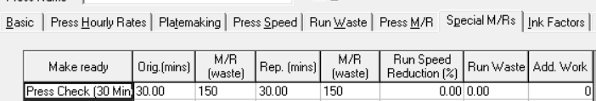
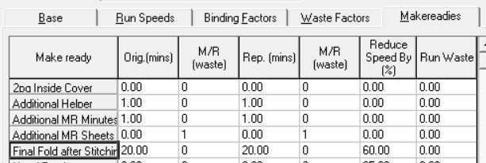
Example of Press Check Modifier
Example of Stitcher Modifier
Notes:
2 min
Note that modifiers are qualifiers that estimating can add on to various functions. In this case for a “Press Check” -
30 additional minutes are added to production time/labor as well as additional sheets are added to stock purchase/run.
Example of Stitcher Modifier
20 Additional MR Minutes plus a Speed Reduction

Slide 15
How Estimating receives information from Sales
Sales enters quote information in ENPOINTE ehub Sales Portal.
RFE is then submitted by Sales which is then received by the Estimating Portal/Work Queue
RFE’s are then assigned by Manager (or lead in their absence) to a specific Estimator to work on. This is based on current workload or previous association with project.
Sales is responsible for giving accurate information to Estimating.
Estimating will ask Sales for clarification if there are any discrepancies or missing information
Demonstration of entry in Print Stream of sample RFE
Notes:
@ 20 minutes
Show example of RFE submission request in Sales Portal
Reinforce what estimating’s SOP is regarding RFE requests
Communicate that the information we receive rarely is accompanied by artwork. Estimating is just that – an estimate until final artwork/quantities/etc. are seen
Live Demo of estimate entry in Print Stream
You have:
Demonstrate how estimates are created to the E-Hub Sales Portal, then submitted to the estimating Portal.
Demonstrate a Simple Estimate (Pre-Determined) to show how estimates are built.
Review Estimate to demonstrate the aspects of the estimate which create times and suggested sell pricing.
Elsa to pull up pre-written RFE Submission in Portal
Elsa to Create Estimate (Print Components and Bound Components) while Brian give a play-by-play

Slide 16
What am I seeing when I look at an Estimate or Job
Top sheet of Estimate: Synopsis of Material & Labor in the estimate detail
Itemization of functions: Pre-Press, Paper, Press, Finishing and Component Finishing.
Notes:
@ 5 minutes
Show example of test estimate – test job to show “Print Outs”
Explain how hours shown on estimate is a combination of MR & Run times.
Note that any helpers added in automatically or by over-ride is covered by estimated costs and not as a separate line-item entry.
You have:
Explain that Estimators do-not create job tickets these are created by client services who are the owners of the ticket. However when something is changing or more clarification is needed estimating should be involved in any changes that might need to be made.
Suggest – eliminate Job Ticket review – that would be a 1-1 training function
Live or Screen Capture of Top Sheet?

Slide 17
This was great! – I want to Learn More!!
Suggest follow up with individuals to further understand Print Stream.
Accounting may want further information on Master Files Print and how the coding relates between estimating and activities.
Production would benefit in learning more about pulling up current jobs and looking at these in the estimating mode to see further details.
Production may want to further their knowledge to know how to calculate costs associated with changes between estimating and production.
Note that although we’ve not touched on the Lettershop side of estimating that could also be done on an individual basis.
Notes:
@ 3 minutes - Wrap up

Slide 18
Thank You.
Brian Norman & Elsa Keil
We’re here to help!

